Slide 1
How to draw … a new ImageJ Logo*!
*well, my submission for a new ImageJ logo…

Slide 2
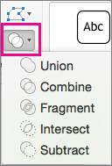
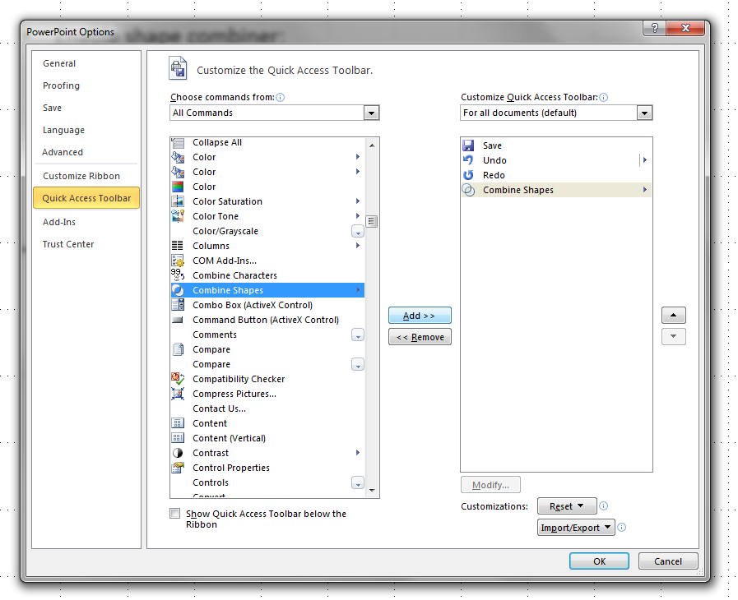
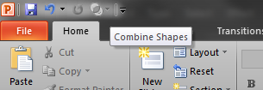
Setup – you will make your life easier if you…
Enable (or learnt to find) the Shape Combiner tool.
Older versions of PowerPoint have this hidden away.
Newer versions of PowerPoint include this tool in the Shape Format tab.
PowerPoint 2010 & 2013 - add it to your QuickAccess toolbar:
Open File → Options → Quick Access Toolbar
Change dropdown ‘Choose commands from:’ to be ‘All Commands’
Scroll down and find ‘Combine Shapes’
‘Add >>’ and then ‘OK’. You’ll have the tool in your Quick Access Toolbar.
PowerPoint 2016:
Select the shapes to merge. Press and hold Shift to select multiple shapes.
The Shape Format tab appears.
On the Shape Format tab, click Merge Shapes, and then pick the option you want.
PowerPoint 2010 & 2013 This will appear in your Quick Access Toolbar!

Slide 3
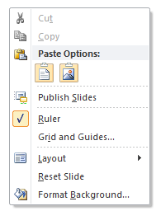
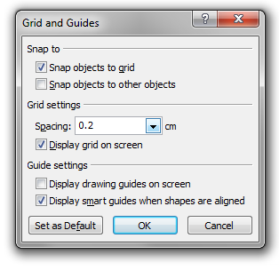
Setup
Enable the grid:
Right click on empty area of slide.
Select ‘Grid and guides…’
Check ‘Display grid on screen’ with 0.2 cm spacing (5 grids per cm).
Check ‘snap objects to grid’.

Slide 4
Draw a circle with 2 cm diameter, centred over a grid intersection.
Draw anything with the ‘oval’ tool, then right-click it and select ‘Size and position…’ then type in the exact values (2 cm for height and width) and click OK.
Drag the shape until it snaps into the position at an intersection of the on-screen grid.
Draw two more circles, centred over the first circle. Draw in this order so the smaller circle is on top of the larger one:
6.4 cm, then
2.4 cm
Ctrl-click the two circles you just made to select them both.

Slide 5
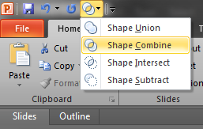
Click the Shape Combiner and select ‘Shape Combine’.
The first circle you drew is now visible again through the hole.

Slide 6
Draw a rectangle 4 cm by 4 cm
As before, draw an arbitrary shape with the rectangle tool then right click the shape, and select ‘Size and position…’. Type the dimensions in as above.
Drag this square so that the top-left corner is aligned with the centre of the first circle.
Ctrl-click the torus and the square.
Select ‘Shape Intersect’ from the Shape Combiner menu.
You’ll be left with an arc shape

Slide 7
Draw a rectangle 2.0 cm by 3.2 cm.
Align the rectangle so that the bottom edge cuts through the centre of the first circle.
Duplicate the first circle (select it and type ctrl-D) and align the copy to one grid-space (0.2 cm) above the rectangle.
Ctrl-click the two circles and the rectangle. Duplicate them and drag them so they are right-aligned with the arc shape.

Slide 8
Duplicate the first circle again and align it with the bottom of the arc shape.
Select all the shapes comprising the ‘i’ character (including the top circle).
From Shape Combine, select ‘Shape Union’.
Repeat for all parts of the ‘j’ character.
Select the ‘i‘ and click the ‘Format’ tab.
Select ‘Shape Fill’ to ‘More Fill Colours…’ and ‘Custom’.
Enter RGB values: R: 0, G: 150, B: 255 and click OK.
Repeat for the ‘j’ using RGB values: R: 255, G: 204 , B: 0.
Select both shapes and change ‘Shape Outline’ to ‘None’.

Slide 9
For ease-of-use, select both shapes and group them (right click and select ‘Group’ and then ‘Group’).
For a monochromatic logo, select the grouped shape and change the ‘Fill Colour’ – both shapes will become the same colour.
When resizing the logo, be sure to check ‘Lock Aspect Ration’ in the Size properties.
You can also hold down the shift key when doing a free-resize using the mouse to preserve the aspect ratio.

